Slide 1
Towards Practical Smile Detection Jacob Whitehill, Gwen Littlewort, Ian Fasel, Marian Bartlett and Javier Movellan
Kamna Yadav
A02048769

Slide 2

Why Smile detection?
Smile detection in face images captured in unconstrained real-world scenarios is an interesting problem with many potential applications.

Slide 3
Current Technologies
Boosting pixel differences
Feature extraction + SVM
HOG features
Gabor Energy Filters
Box filters
Gradient of Self-Similarity

Slide 4
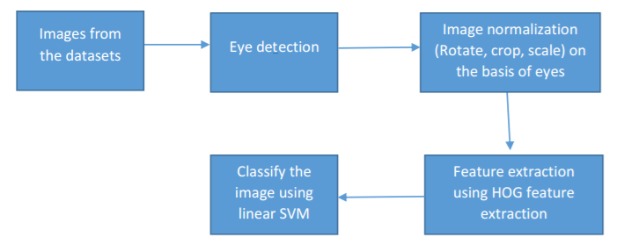
Proposed Approach

Slide 5
Proposed Approach…
Face detection
Using vision.CascadeObjectDetector('FrontalFaceCART‘)
Eye detection
Using vision.CascadeObjectDetector(EyePairBig‘)
Image registration
Identify bounding boxes of both eyes
Detecting the angle between the two bounding boxes
Image rotation using the identified angle
Cropping the area of interest from rotated image
Resizing the image to 64 X 64 dimensions

Slide 6
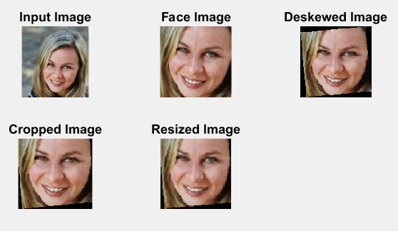
Proposed Approach…
HOG Feature extraction
Using extractHOGFeatures()
Training and Classification
Using fitcsvm() for training the classifier
Predict() for prediction of class for input image

Slide 7
Improvements
In order to improve the accuracy, Gradient of Self-similarity features approach was tried as per ‘SMILE DETECTION IN UNCONSTRAINED SCENARIOS USING SELF-SIMILARITY OF GRADIENTS FEATURES’
For this approach, instead of getting HOG features for the whole face image, the image is divided into 16 cells before HOG extraction.

Slide 8
Performance and accuracy details
Algorithm | Dataset | Data pre-processing and feature extraction (sec) |  |  | SVM training (sec) | SVM Prediction (sec)
 |  | Positive training | Negative training | Testing data
Original | Genki | 188.14 | 133.26 | 108.14 | 24.37 | 0.167
 | Smiles | 39.60 | 110.05 | 49.74 | 14.34 | 0.057
Optimized | Genki | 209.57 | 145.63 | 117.82 | 29.64 | 0.009
 | Smiles | 43.93 | 120.03 | 52.66 | 15.87 | 0.010
Dataset | Accuracy (%)
 | Original Algorithm | With Optimization
Genki Dataset | 90.9313 | 45.8333
Smiles Dataset | 50.00 | 61.4678

Slide 9
Conclusion
Using HOG for feature extraction and SVM for the classification part has given us better accuracy than just focusing on the pixel differences by identifying teeth or specific features in face

Slide 10
Future Work
The current approach is not illumination invariant. So there is a scope of improvement by making the face and feature extraction part more robust.

Slide 11
Thank You

